Slide 1
Spike Sorting Acceleration Beamforming Acceleration
AAHLS Final Project Presentation
109061564 馬婕芸
110061551 呂易縉
110061540 賴聖耘

Slide 2
Outline
Spike sorting acceleration
Spike sorting system
Proposed end-to-end system diagram
Discrete wavelet transform kernel
Issues with K-means kernel
Contribution
Beamforming acceleration
Work distribution
Reference
GitHub: https://github.com/jieyunma/AAHLS_final.git

Slide 3
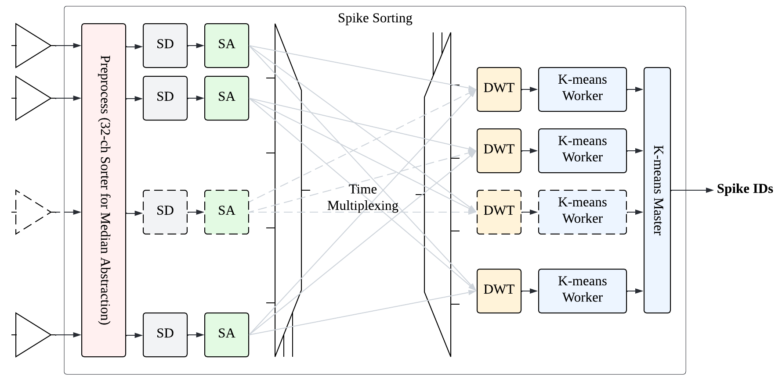
Spike Sorting System

Slide 4
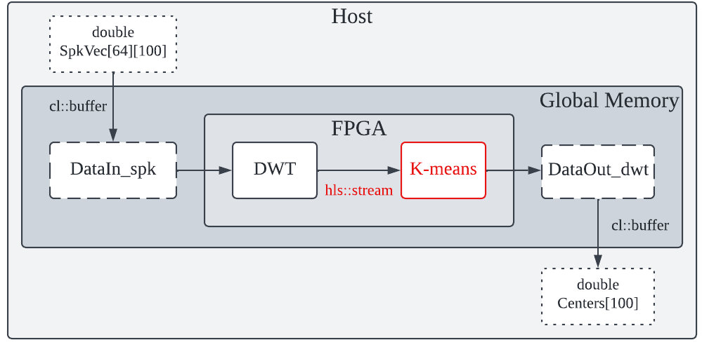
Proposed System Diagram
Whole system is feasible or not ?
K-means algorithm provided by Vitis Library is scalable or not ?
Throughput/resource in a multi-channel design ?

Slide 5
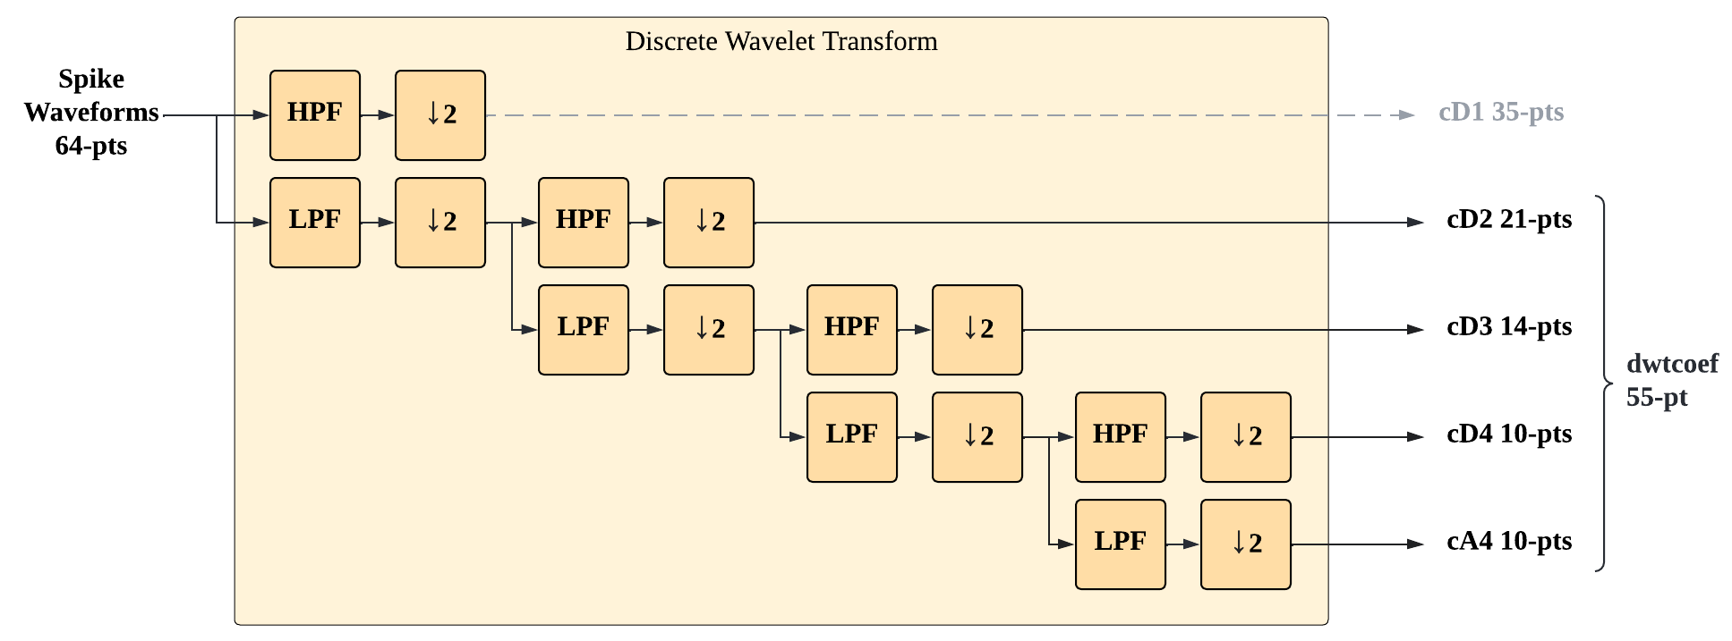
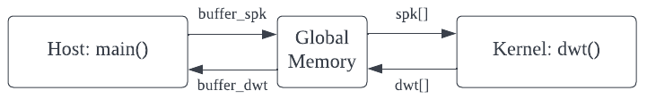
System Functionality (DWT)
double HiD[8] = {-0.0322, -0.0126, 0.0992, 0.2979, -0.8037, 0.4976, 0.0296, -0.0758};
double LoD[8] = {-0.0758, -0.0296, 0.4976, 0.8037, 0.2979, -0.0992, -0.0126, 0.0322};

Slide 6
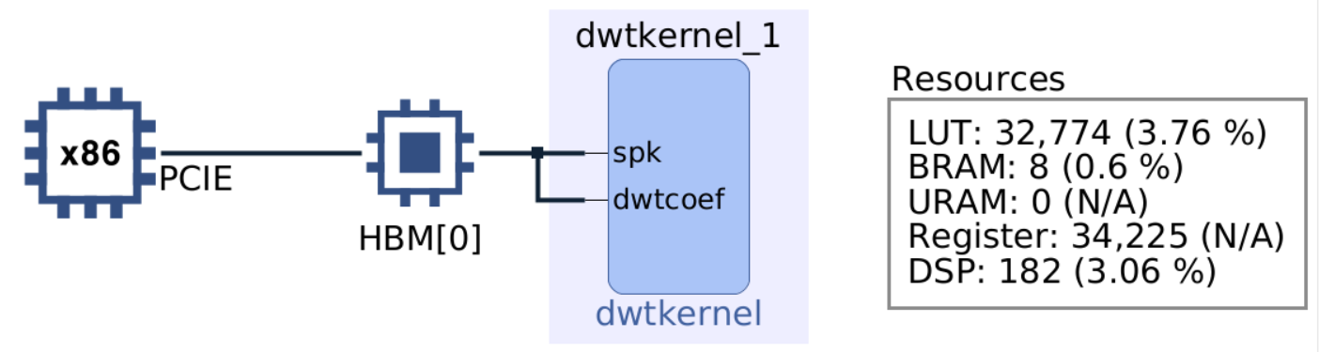
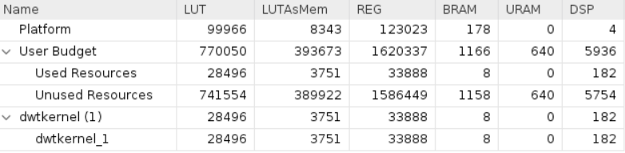
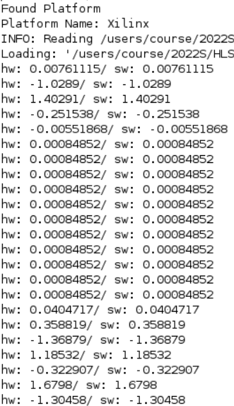
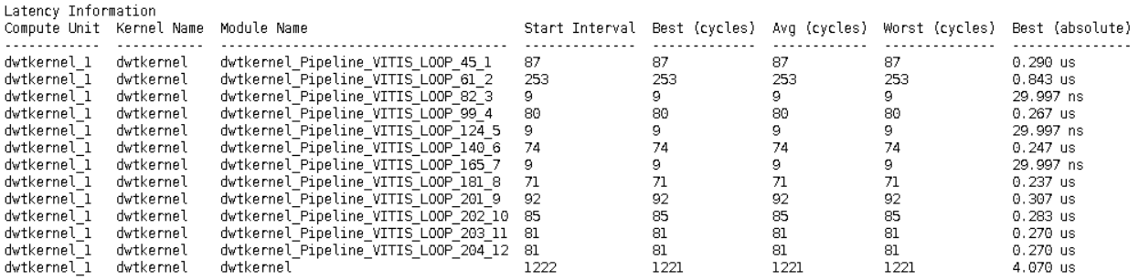
DWT Results

Slide 7
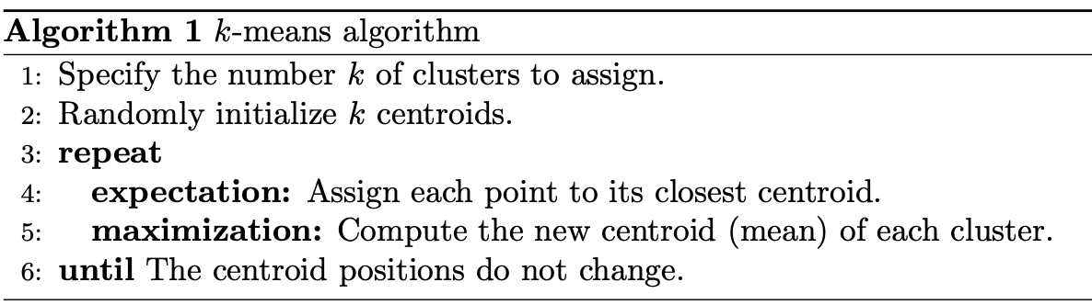
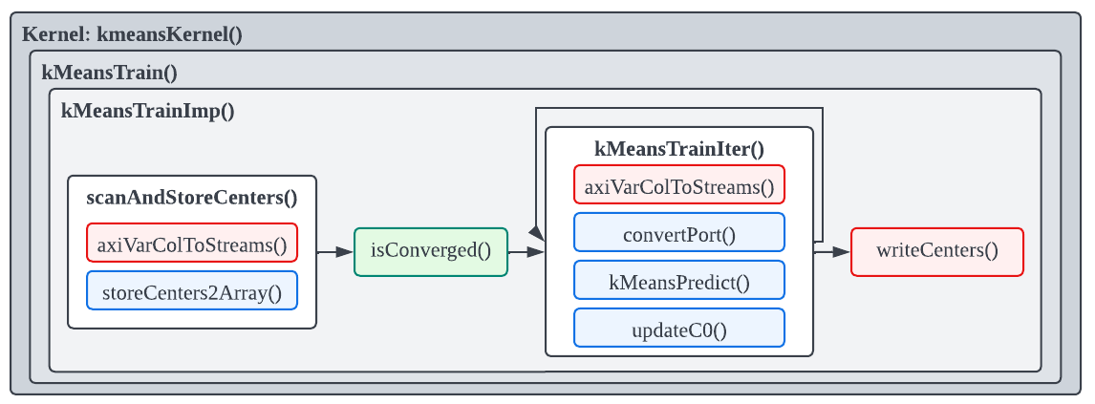
System Functionality (k-means clustering)

Slide 8
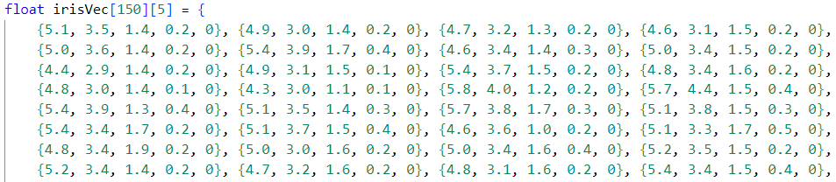
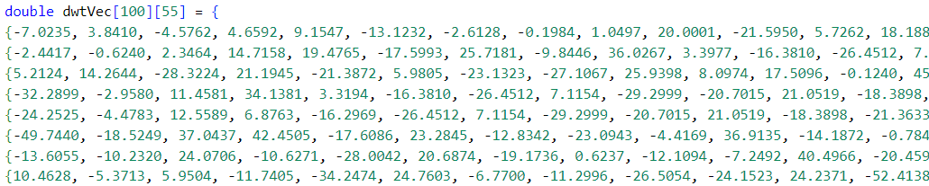
K-means - Dataset

Slide 9
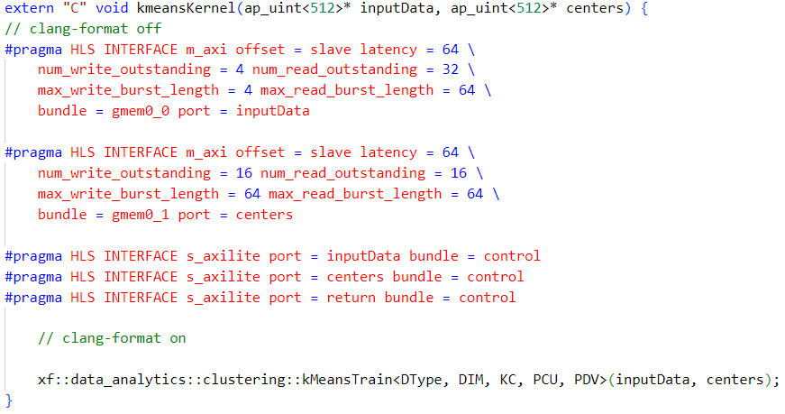
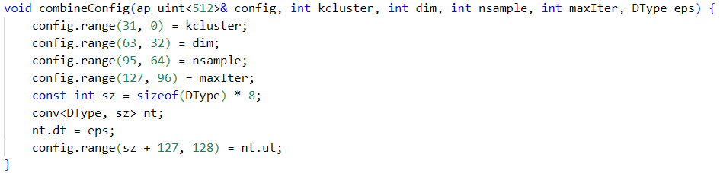
K-means - Interface

Slide 10
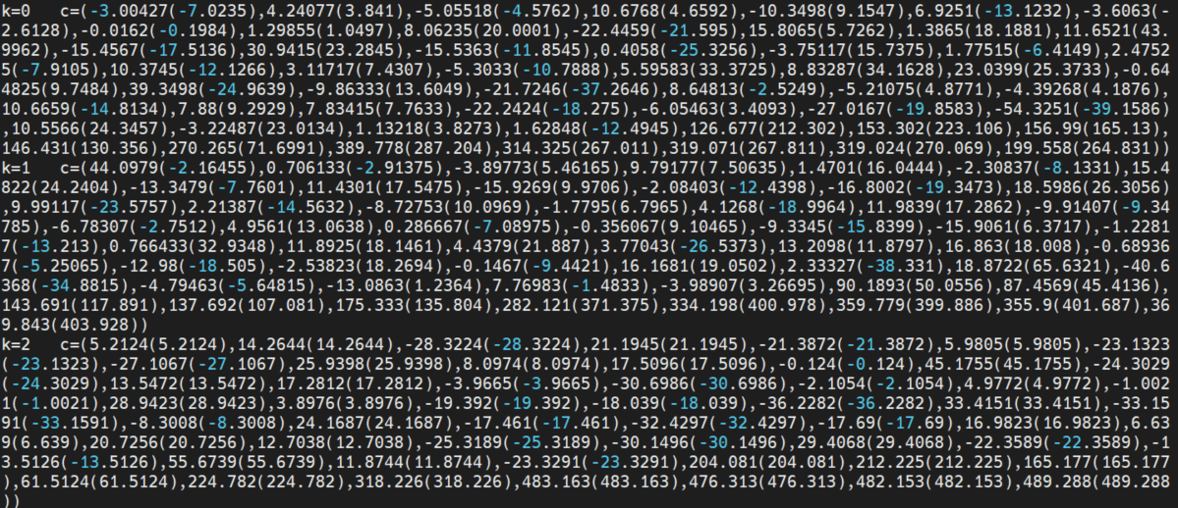
K-means - Emulation
Software emulation is broken.
Only hardware target can be simulated.
When data size is big, it takes forever.

Slide 11
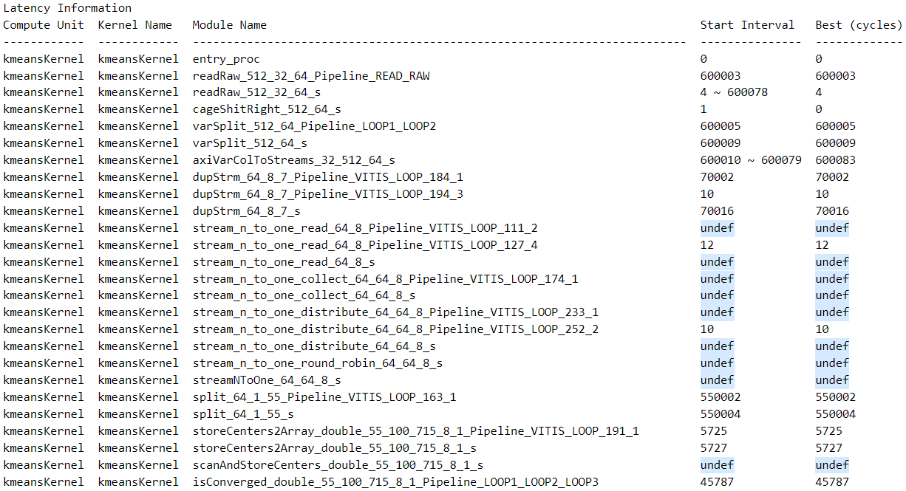
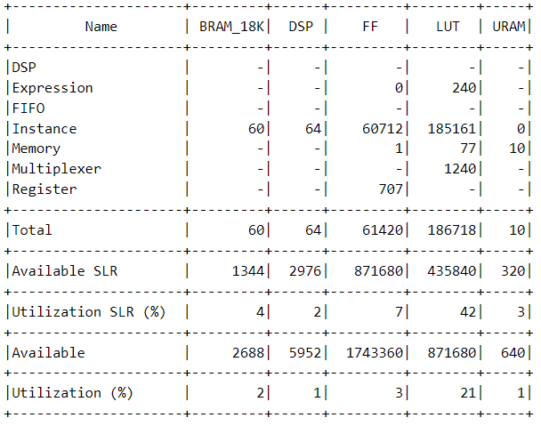
K-means Results

Slide 12
Recall: Proposed System Diagram
Whole system is feasible or not ?
K-means algorithm provided by Vitis Library is scalable or not ?
Throughput/resource in a multi-channel design ?
Contribution

Slide 13
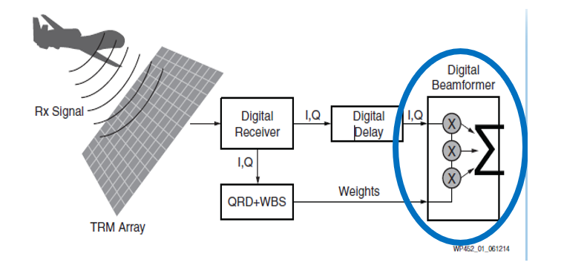
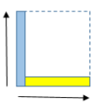
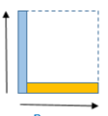
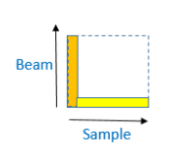
Beamforming system
Reduce set for debug
Channel : 16
Sample : 2500
Beam : 3
Full set from WP452
Channel : 16
Sample : 2500
Beam : 3
Rxi
Wi
Bq
sample
X
channel
+
sample
channel
beam
beam
Rxq
Wq
Bi
sample
X
channel
-
sample
channel
beam
beam

Slide 14
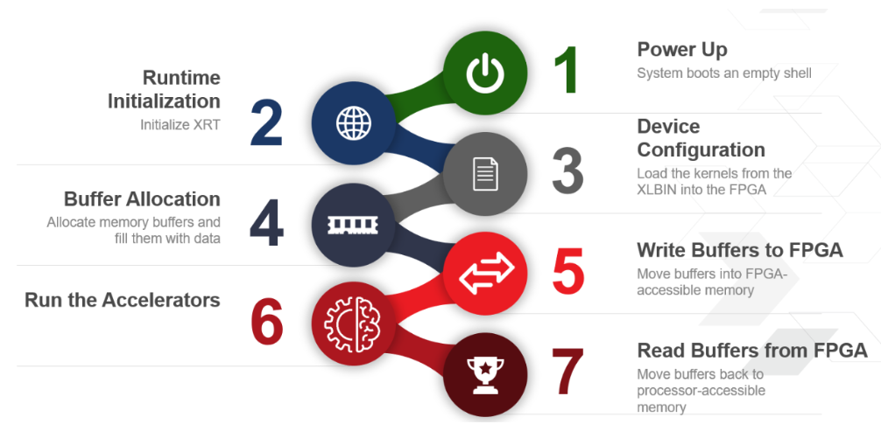
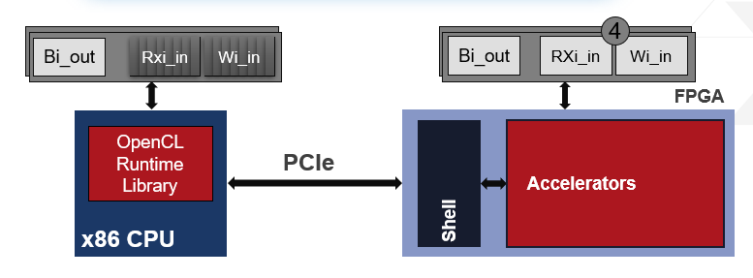
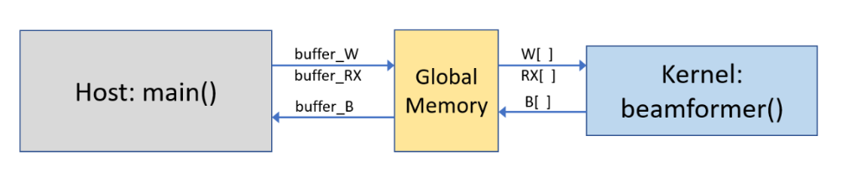
System Functionality (Beamforming)

Slide 15


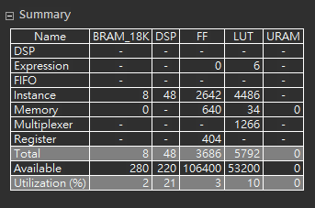
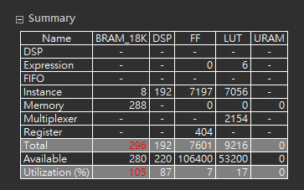
Beamforming directive testing on pynq-z2
Array partition
Pipeline read
Pipeline write
Pipeline loop2(matrix multiplication)
Reduce set
Full set

Slide 16
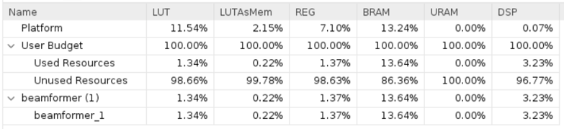
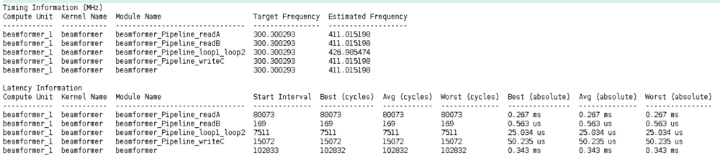
Beamforming Results

